Slide 1
S23 optics & polarity checks during injection test 10.08.2008 14:50-19:15
Verena Kain, Mike Lamont,
Laurette Ponce, Rogelio Tomas,
Walter Venturini, Frank Zimmermann,+…

Slide 2
conditions
low intensity 2x10⁹
further drop during study
initial rf frequency shift -800 Hz kept for
sextupole study ↔ Δp/p ~0.6x10⁻³ (offset Δp/p~-0.5x10⁻³ for zero shift!)
help from Walter & Laurette;
rest of team exhausted from aperture study;
numerous interruptions (meeting, low intensity test, BPM crates down, pressure to finish …)
“parasitic” measurements by Brennan et al.

Slide 3
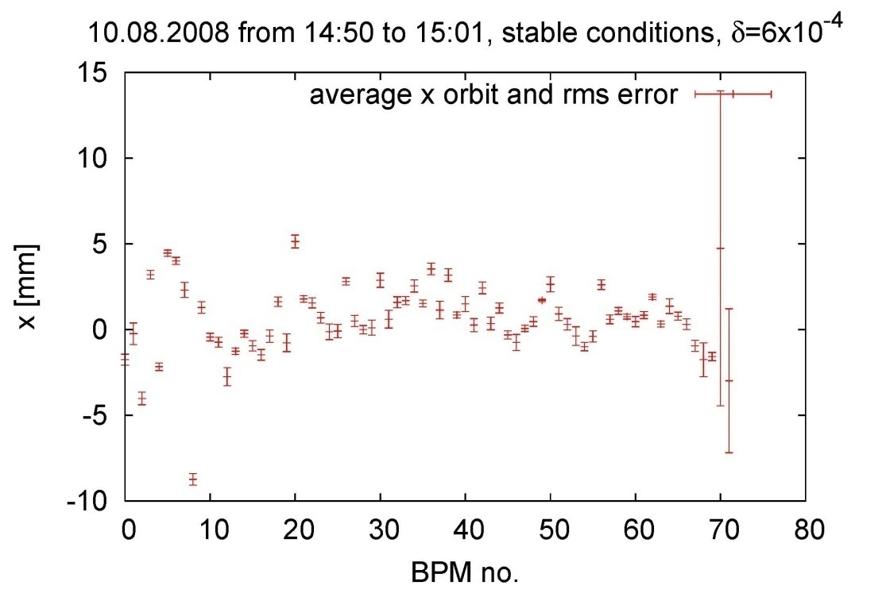
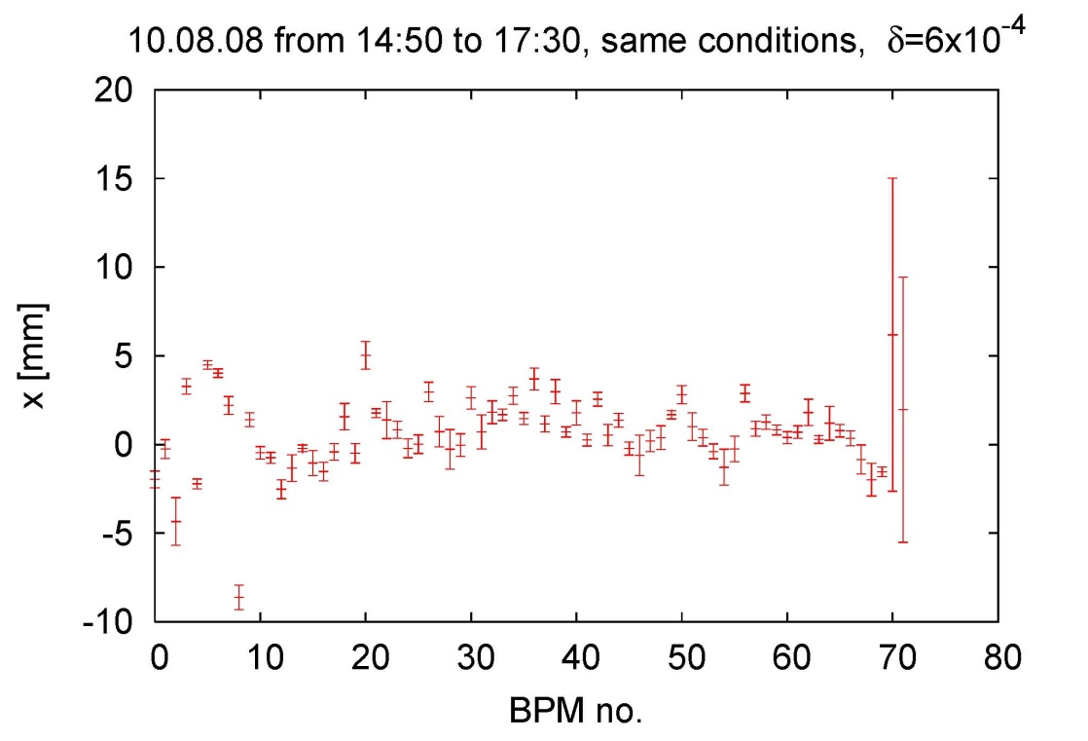
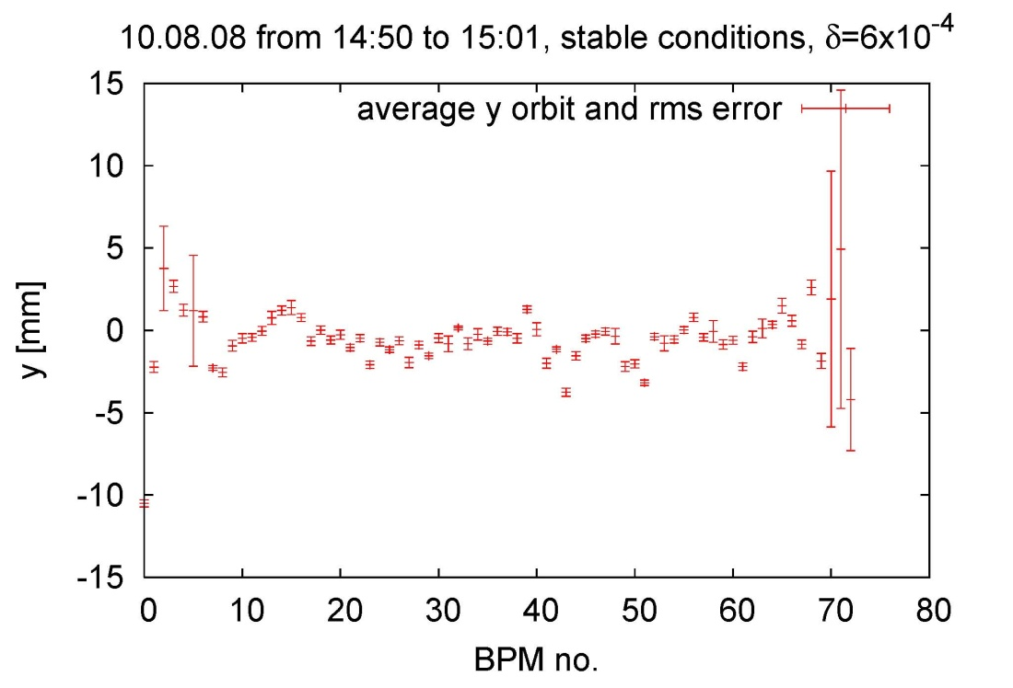
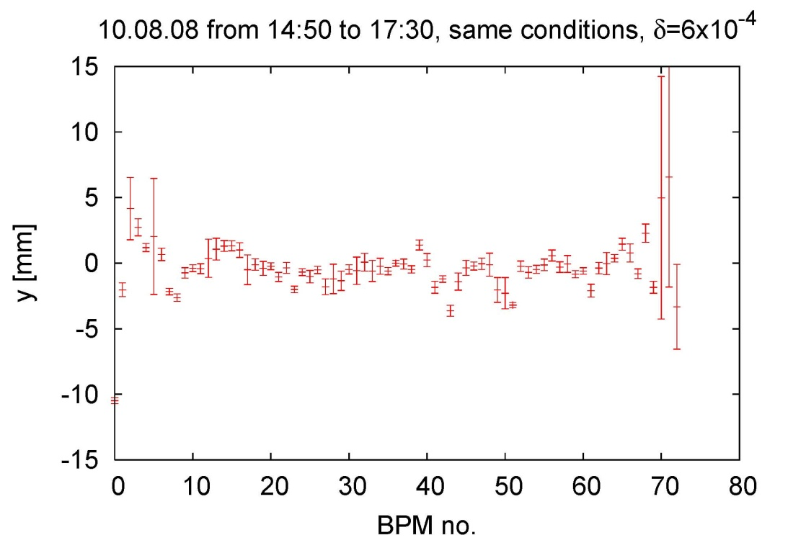
BPM resolution & orbit stability
x, ~10 minutes
x,~3 hours
y, ~10 minutes
y,~3 hours

Slide 4
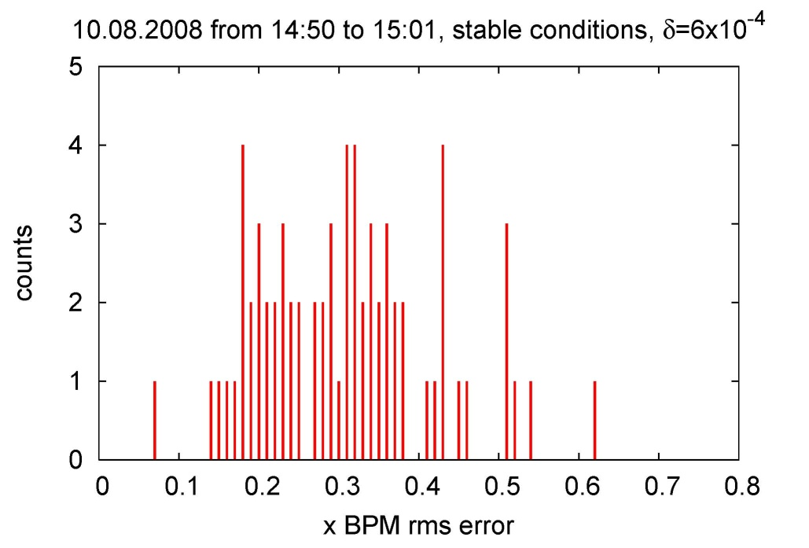
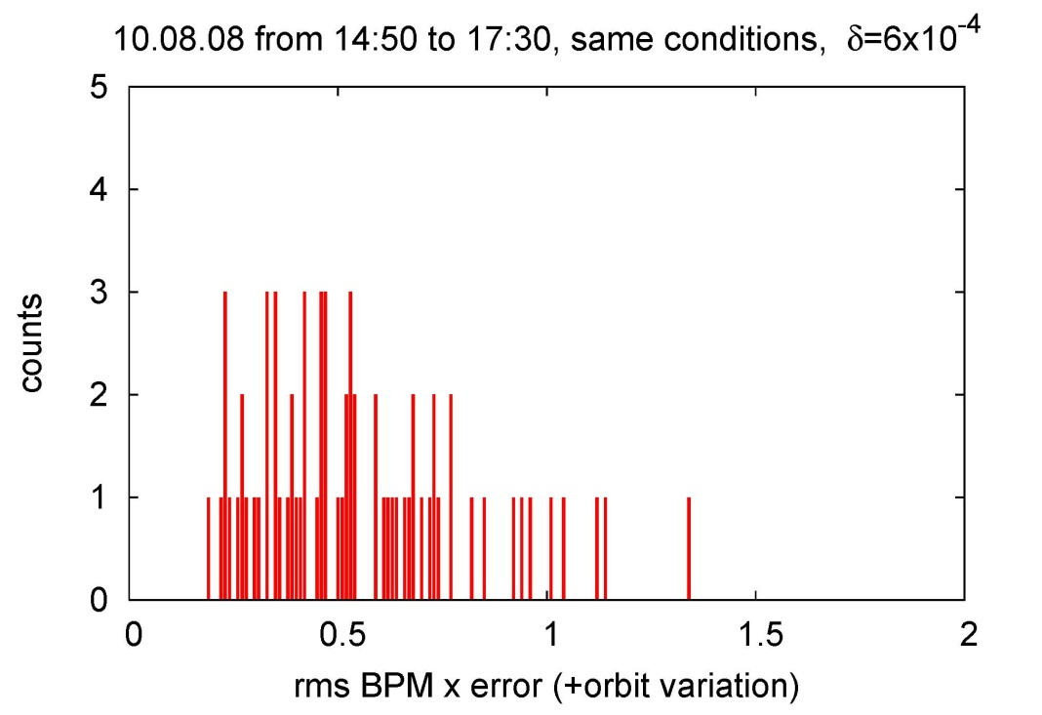
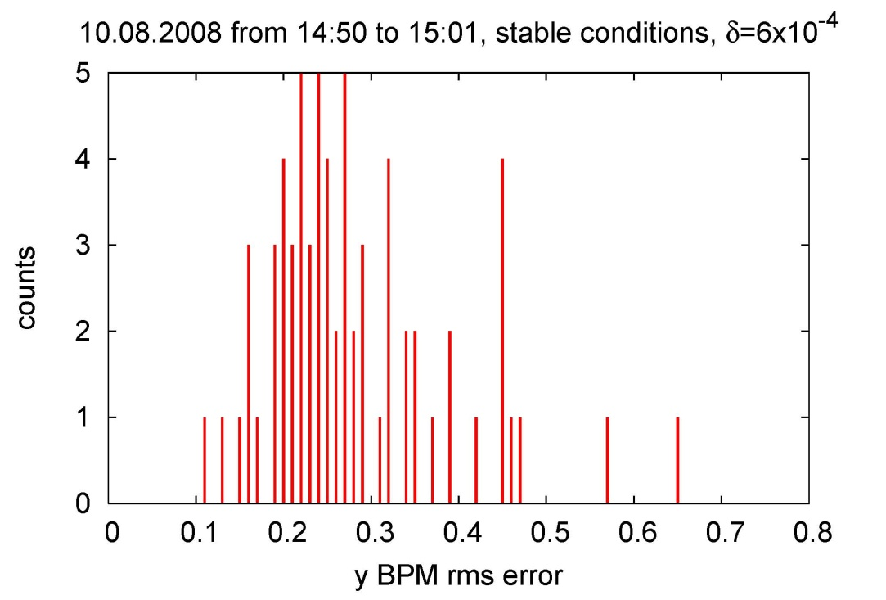
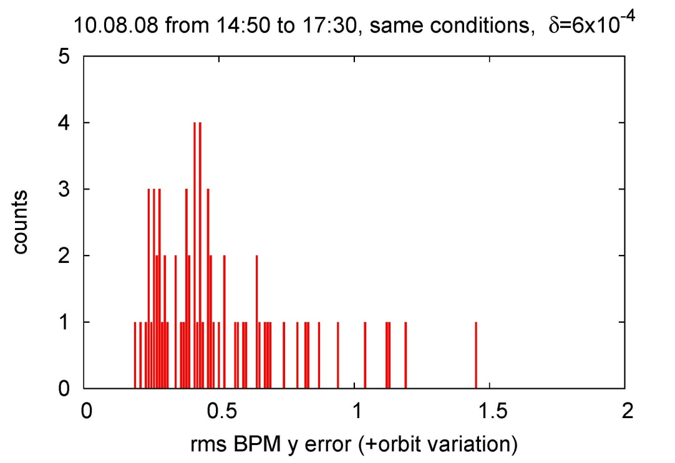
BPM resolution & orbit stability
rms variation of BPM reading
~0.2-0.3 mm over 10 minutes
rms variation of BPM reading
~0.5 mm over 3 hours

Slide 5
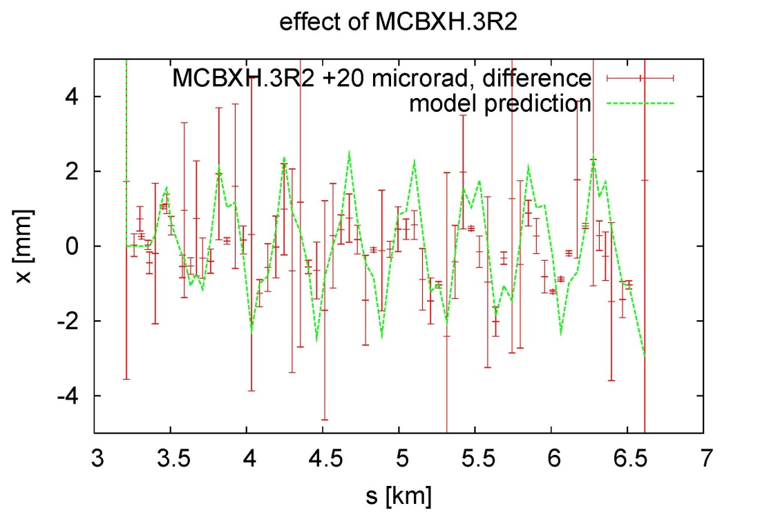
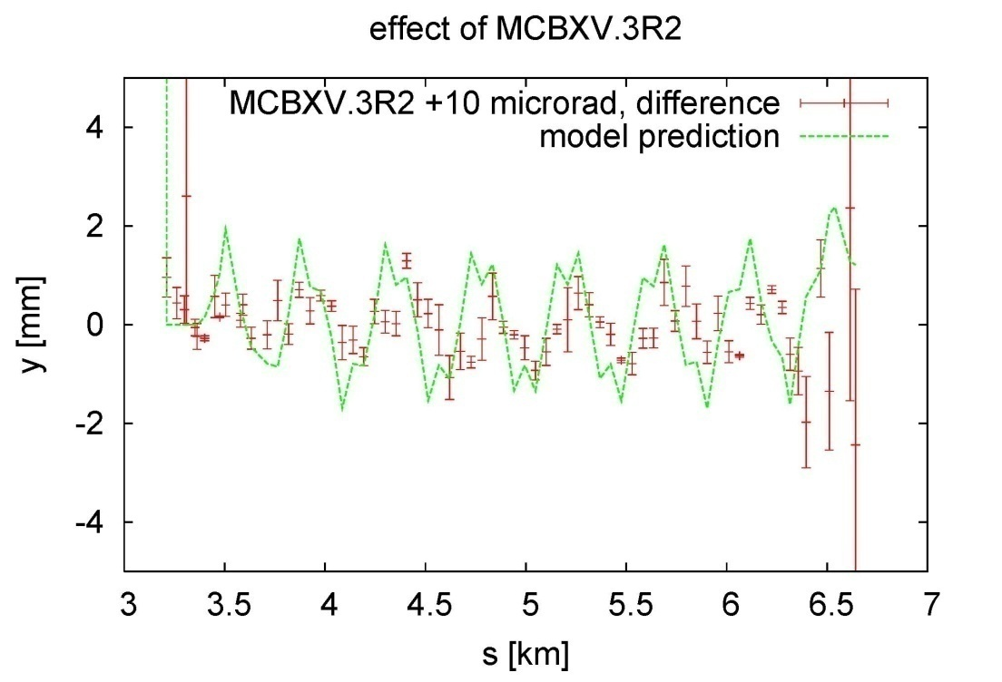
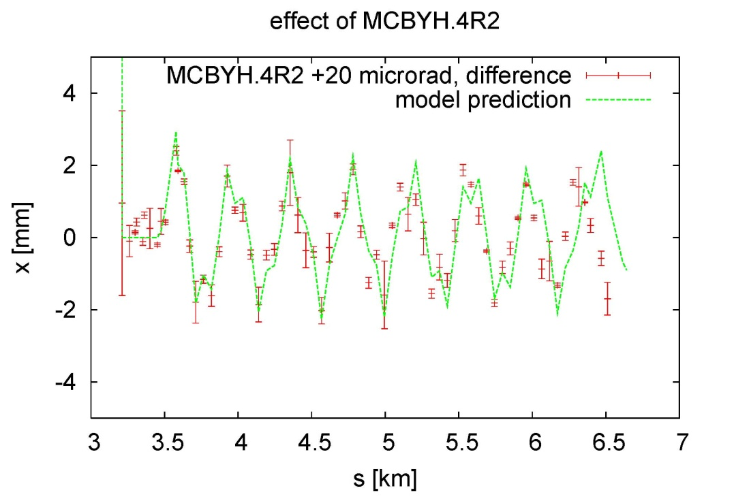
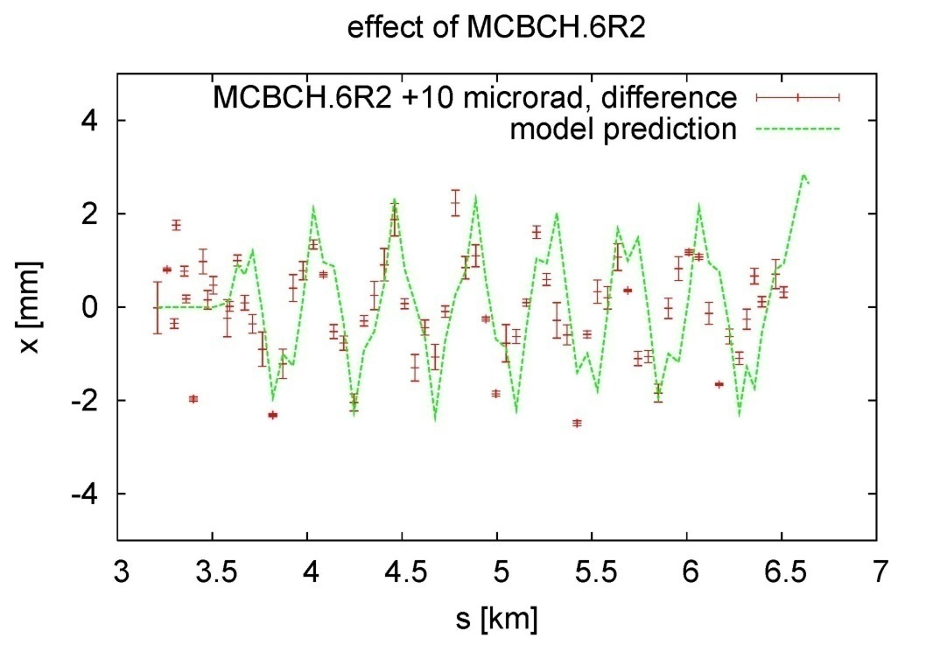
difference orbits w & w/o oscillation
very noisy, but measured x oscillation
may be slightly ahead of model
initial amplitude less than expected?
measured y oscillation in arc
may be slightly behind model
measured x oscillation in arc
may be slightly ahead of model

Slide 6
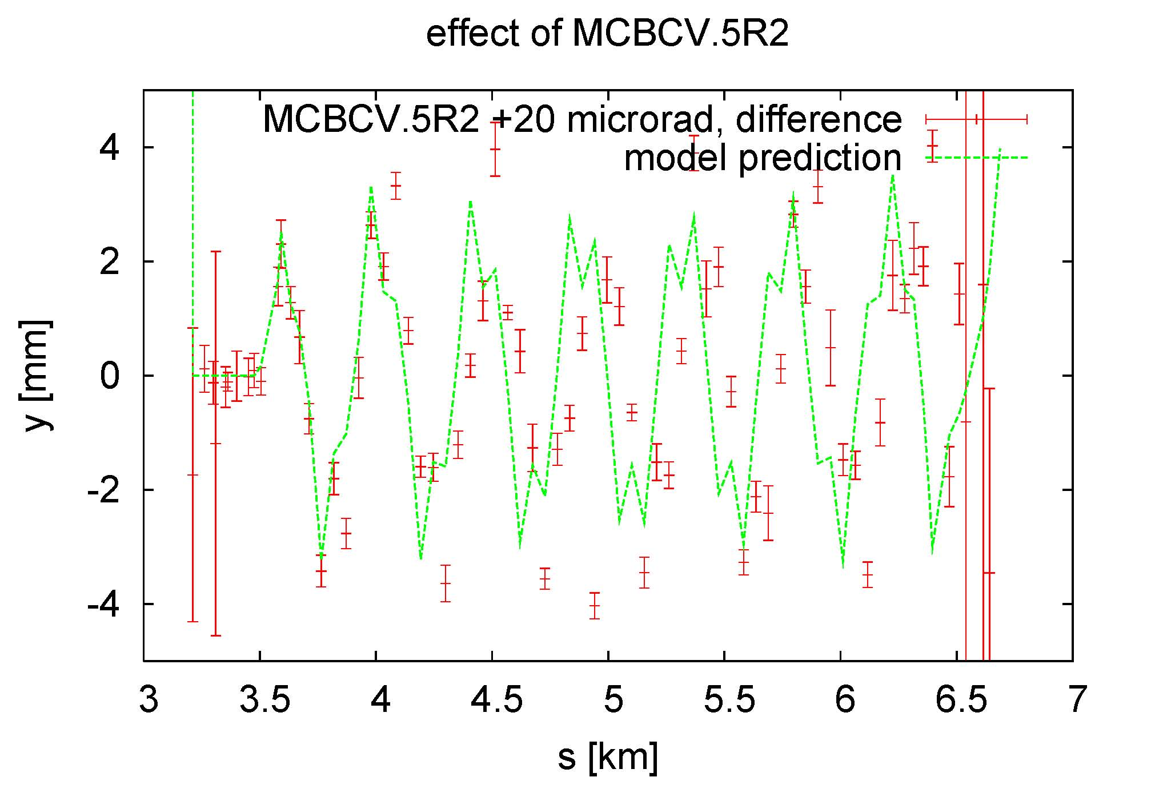
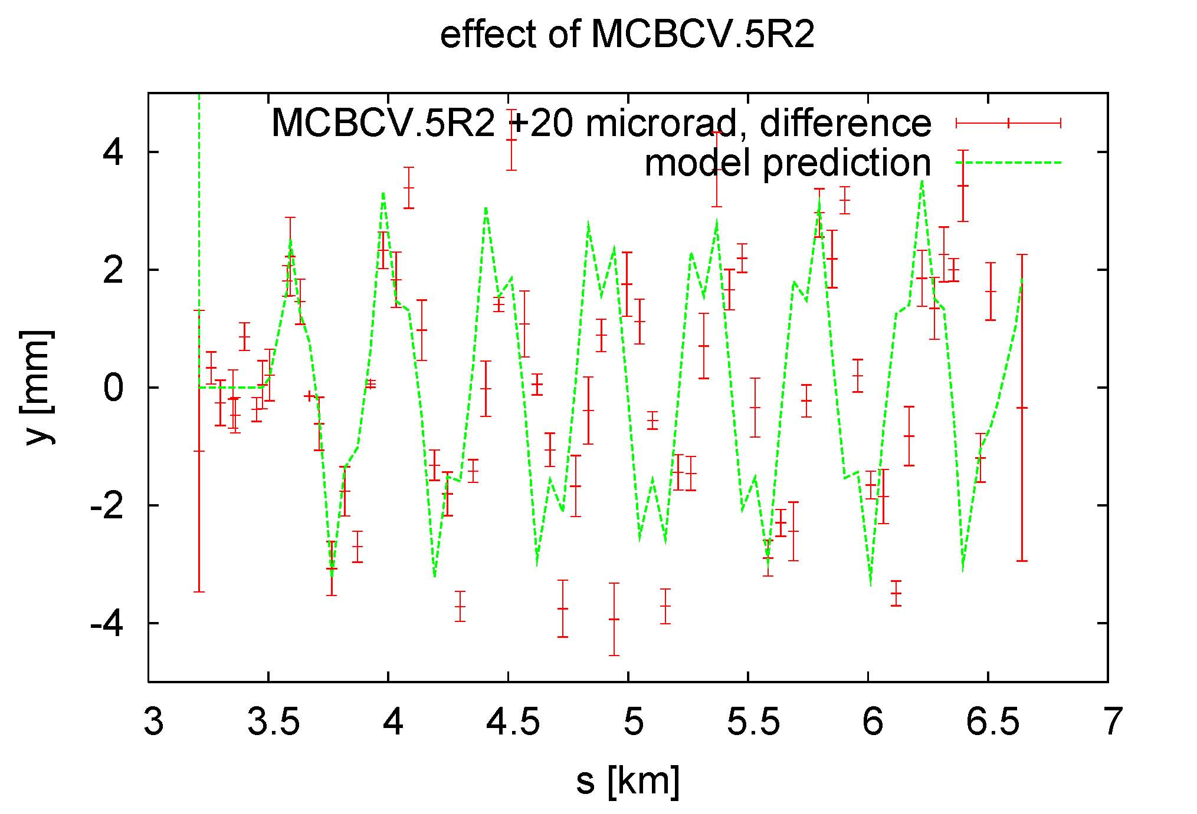
difference orbits w & w/o oscillation
two sets of data with MCBCV.5R2 taken with 2 hours interval
~15:00
~17:00
conspicuous pattern repeats!

Slide 7
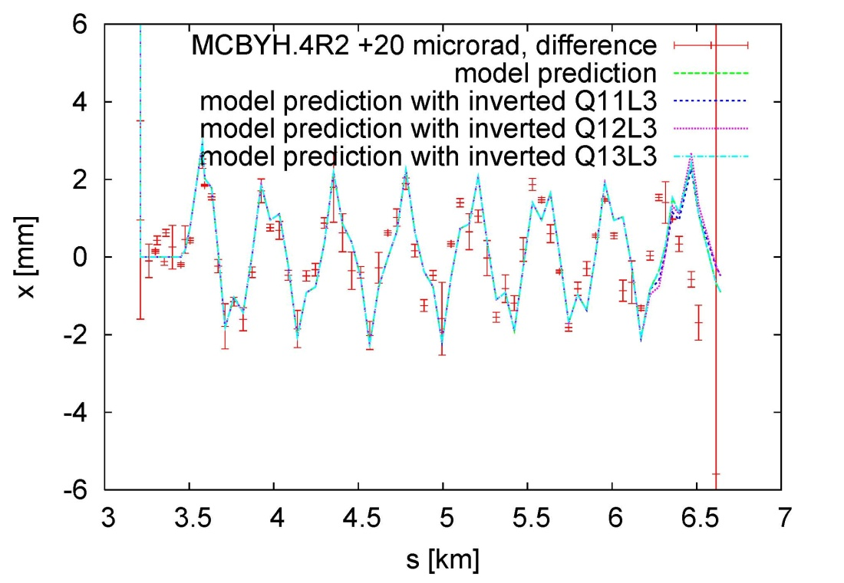
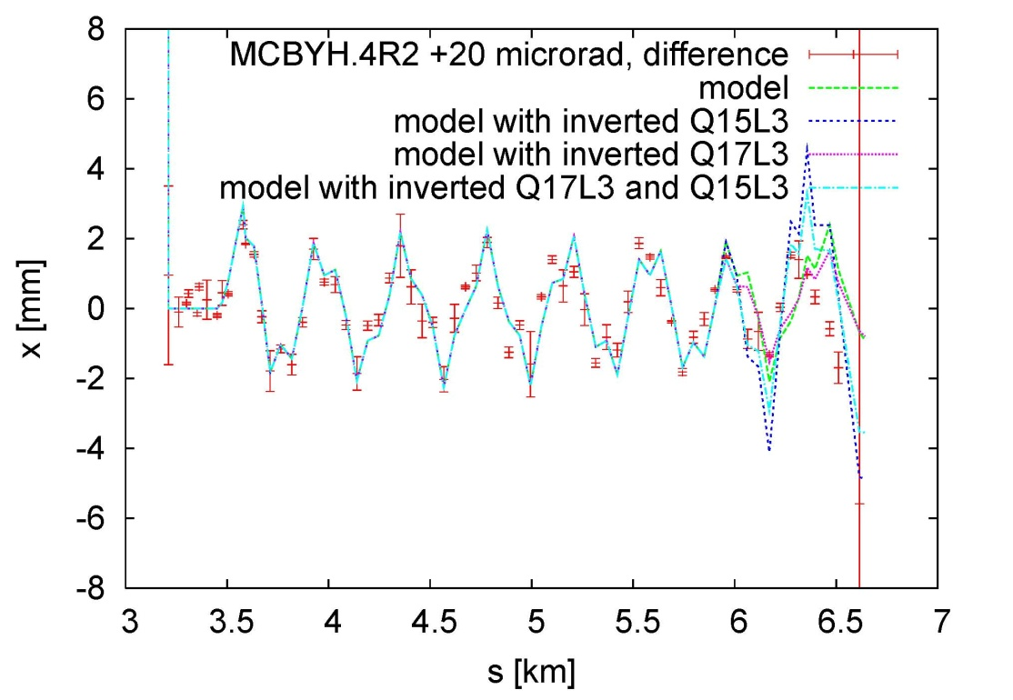
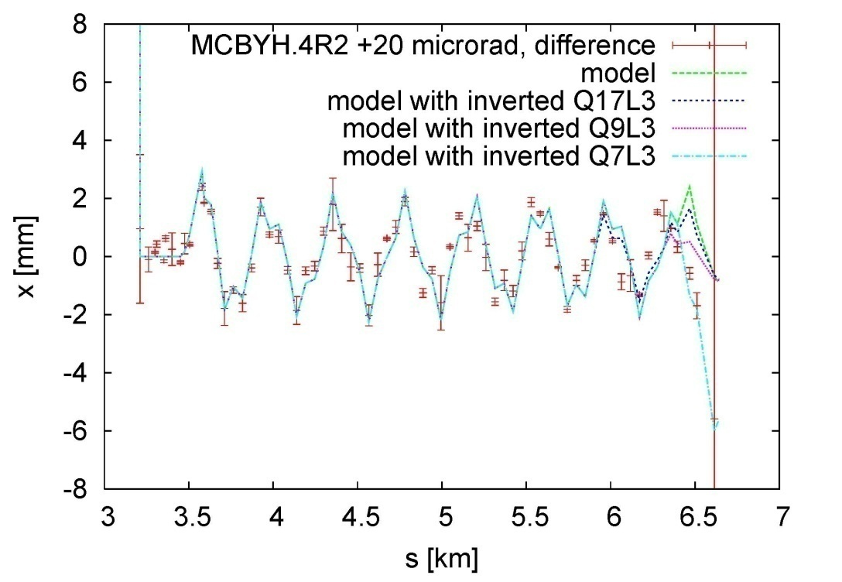
inverting model quadrupoles in L3
inverting Q7L3 gives prediction
~consistent with
x measurement
(but not in y; see
next next slides)

Slide 8
polarity checks
Basic procedure:
launch betatron oscillations with single orbit corrector
change strength or polarity of circuit under investigation, and take four orbits: oscillation for new strength , oscillation for old strength , reference orbit new strength, reference orbit old strength
for sextupole circuits change momentum offset of injected beam
data taken for following S23 circuits:
RSD1&2, RSF1&2, MCS, MSS (slightly off-momentum)
QTL11R2,QTL11L3, QT12R2, QT13R2
QS (no reference orbit)
OD, OF (only one orbit each due to lack of time)

Slide 9
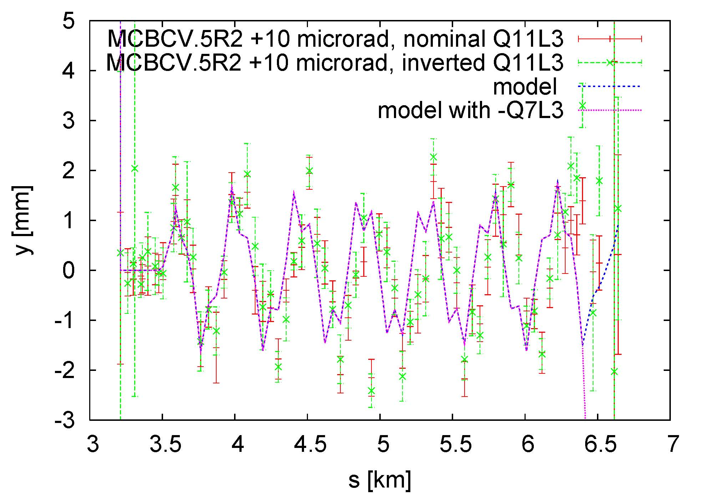
polarity check Q11L3
inverting Q7L3
gives
terrible
result in
y!
measurement with inverted Q11L3 (green dots) is further away from the nominal model (dark blue line)

Slide 10
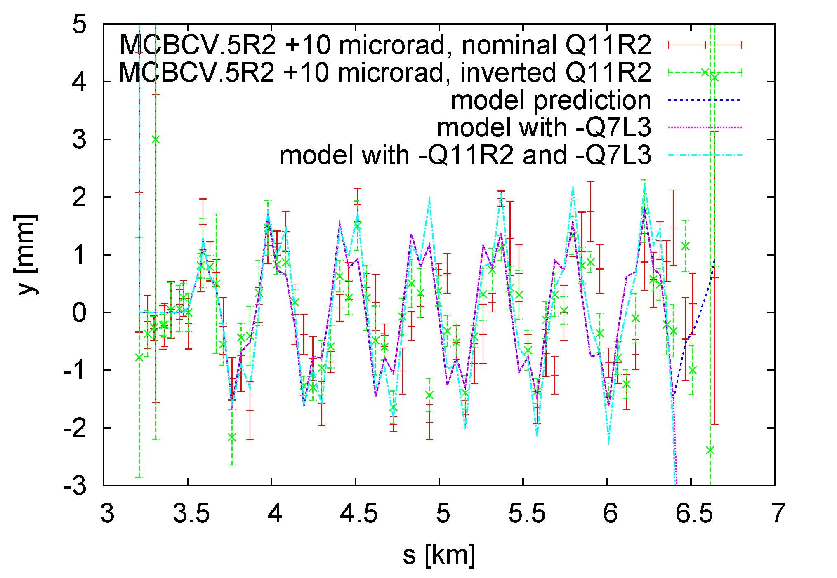
polarity check Q11R2
conspicuous pattern
reproduced
by QTL11R2
inversion
polarity error of BPM33.R2.B1?!
measurement with inverted Q11R2 (green dots) is closer to nominal model (dark blue line) and vice versa!

Slide 11
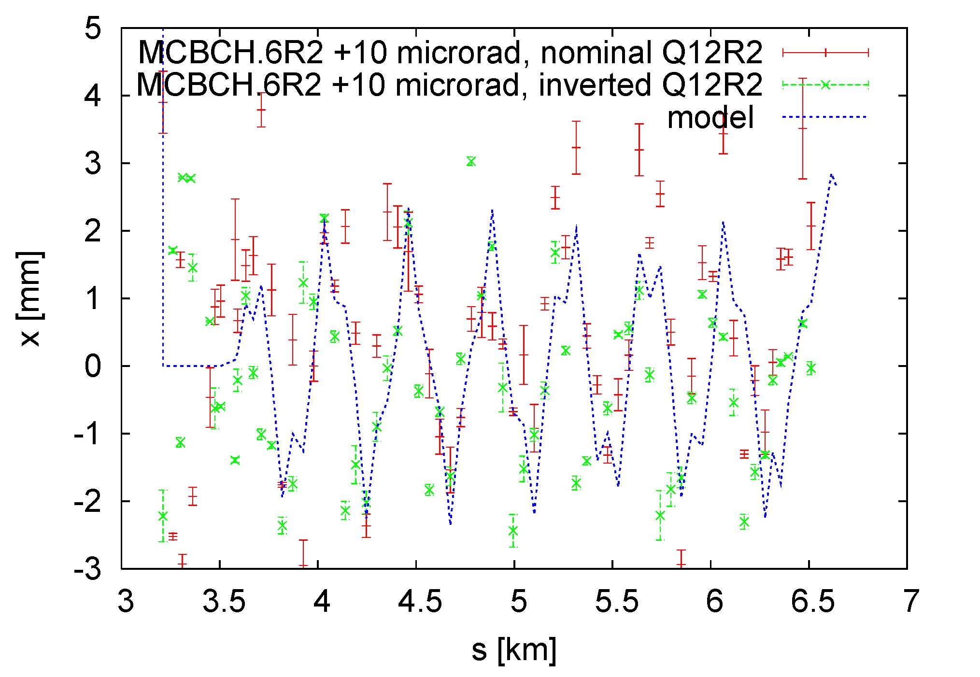
polarity check Q12R2
many noisy BPMs but polarity of Q12R2 looks OK

Slide 12
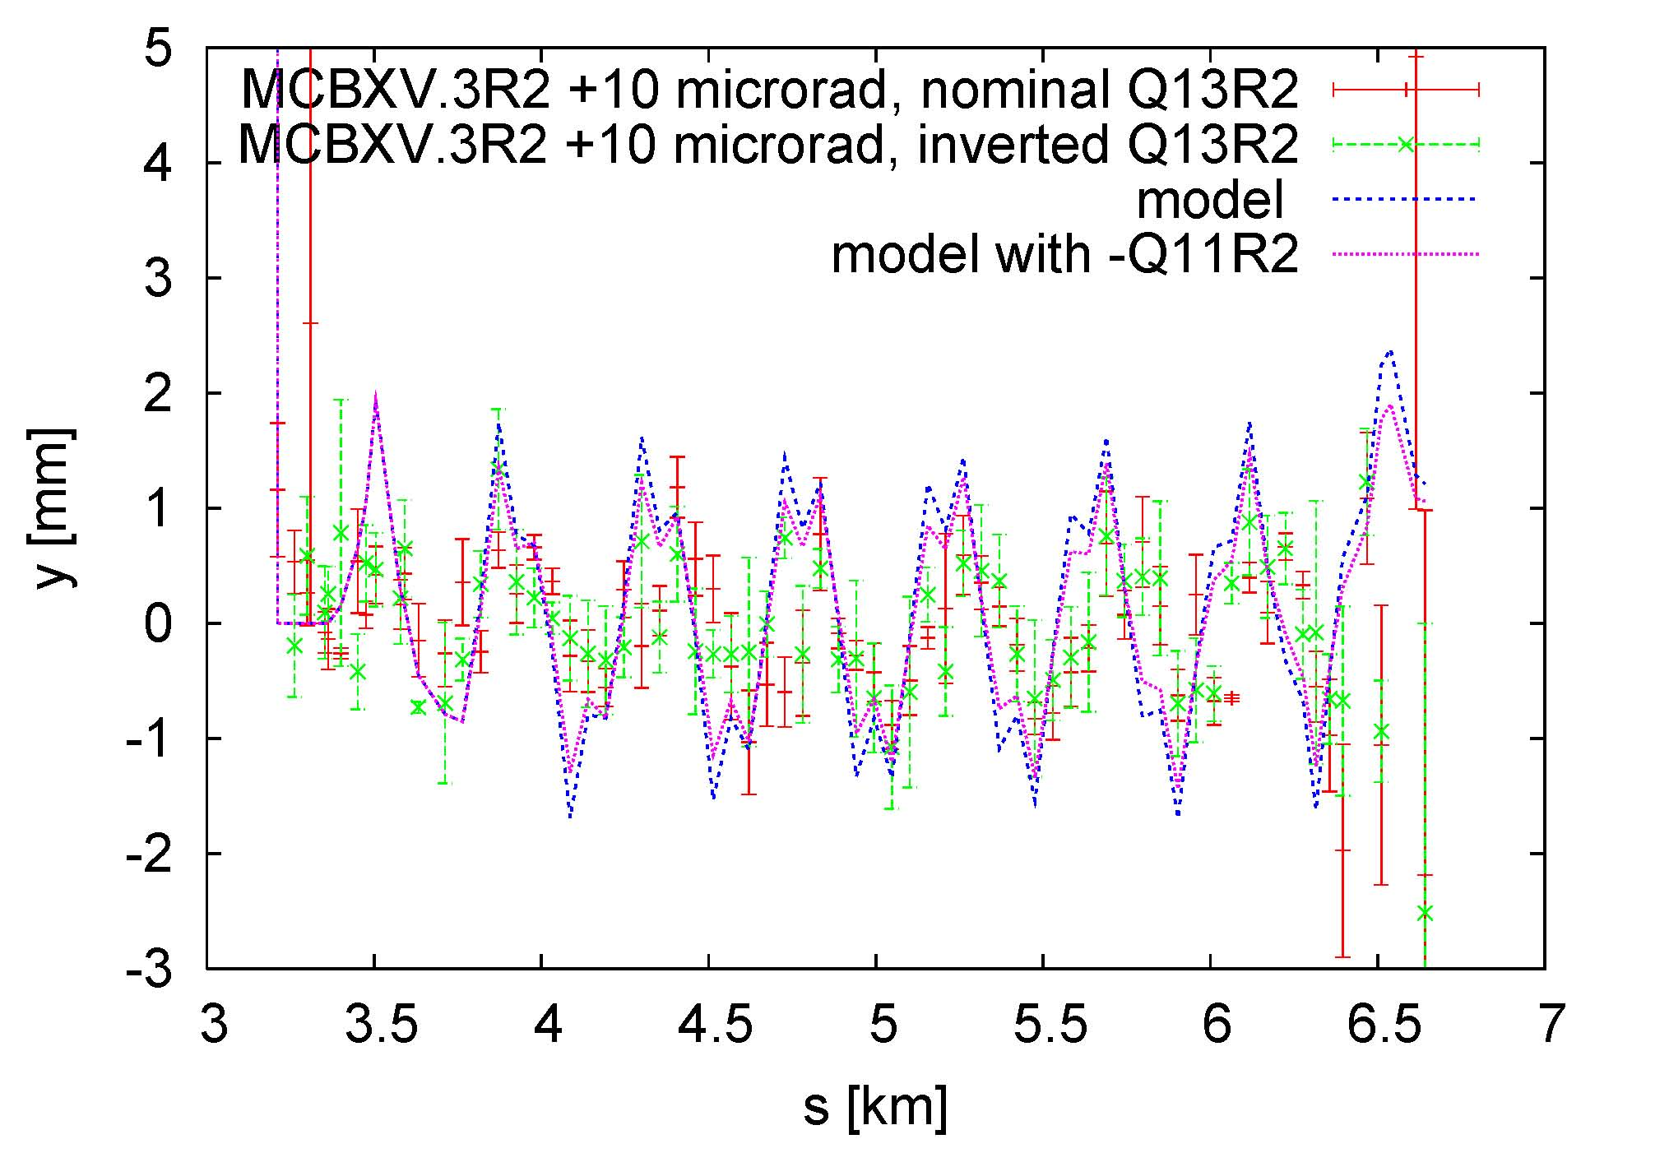
polarity check Q13R2
many noisy BPMs, polarity of Q13R2 may or may not be OK

Slide 13
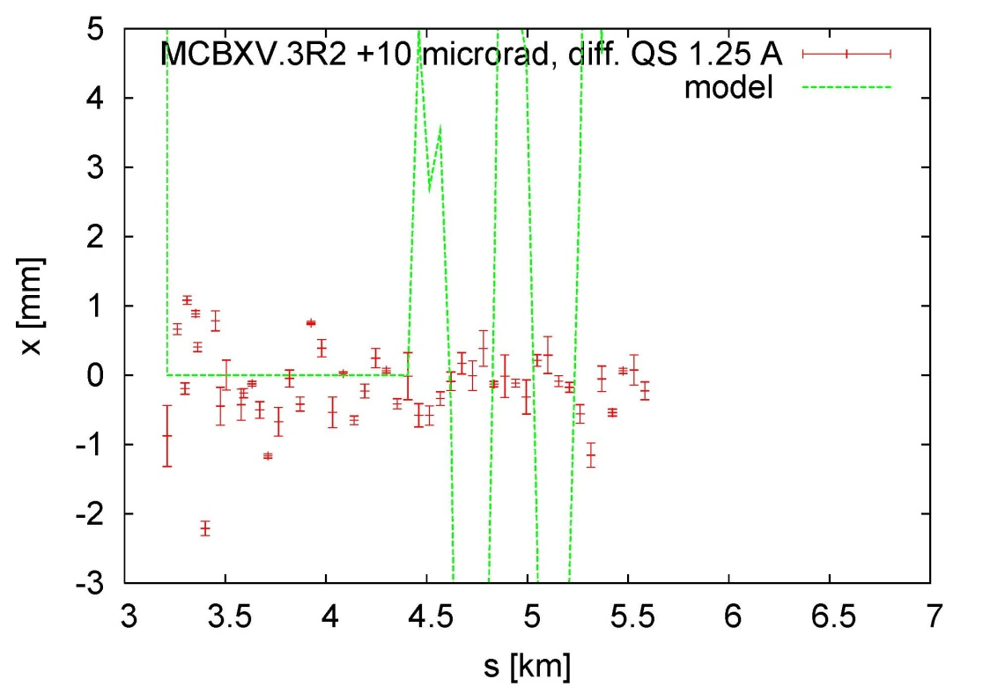
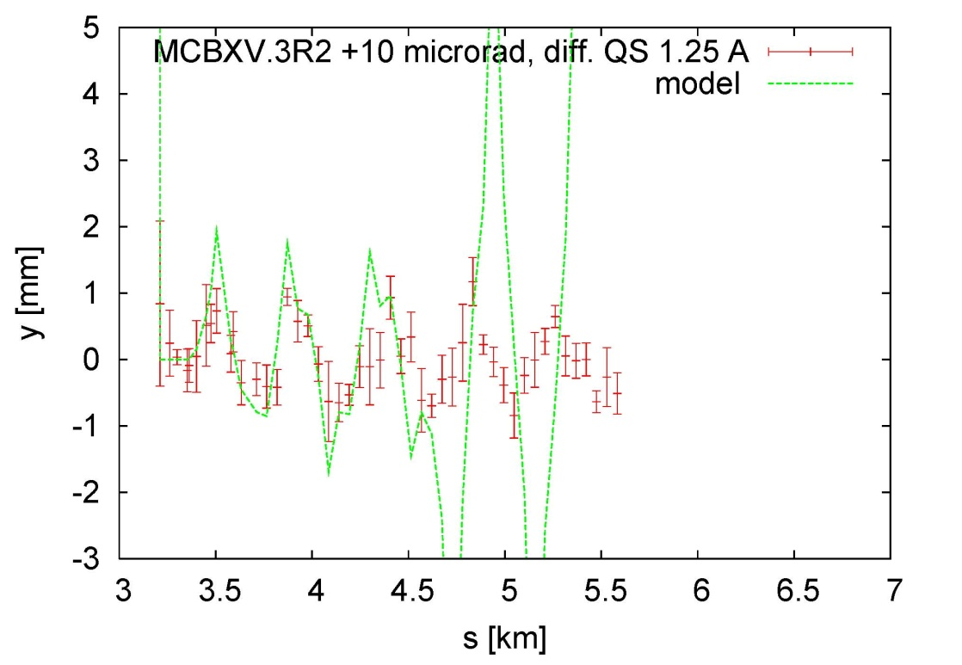
polarity check QS
MQS does not seem to have any effect

Slide 14
preliminary conclusions
Q11R2 appears to be inverted
BPM.33R2.B1 has wrong polarity
there is another (large) optics error between Q17L3 and Q7L3, in x about equivalent to an inversion of Q7L3 (but this is not it)
MQS has no effect; perhaps not connected?
… data analysis still ongoing

